Slide 1
Comparative Economic Organization: The Analysis of Discrete Structural Alternatives
Oliver E. Williamson, 1991
Administrative Science Quarterly

Slide 2
Introduction Discrete Structural Analysis Dimensionalizing Governance Discriminating Alignment Comparative Statics
Overview
Key differences in three generic forms of economic organization: market, hybrid, and hierarchy
Different coordinating and control mechanisms
Different abilities to adapt to disturbances
Distinct type of contract law
Identified parameters that cause shifts in the comparative costs of governance
Property rights
Contract law
Reputation effects
Uncertainty

Slide 3
Introduction Discrete Structural Analysis Dimensionalizing Governance Discriminating Alignment Comparative Statics
Motivation
To extend and refine TCE by responding to leading criticisms:
The institutional environment and the institutions of governance have developed in disjunct ways.
TCE neglects intermediate or hybrid forms by dealing with polar forms –markets and hierarchies.
Dimensionalization of transactions and governance is needed.
TCE has been developed almost entirely with reference to Western capitalist economies.

Slide 4
Introduction Discrete Structural Analysis Dimensionalizing Governance Discriminating Alignment Comparative Statics
Factors that support discrete structural analysis:
Firms are not merely extensions of markets but employ different means.
Discrete contract law differences support and define each generic form of governance.
Marginal analysis is typically concerned with second-order refinements to the neglect of first-order economizing.

Slide 5
Introduction Discrete Structural Analysis Dimensionalizing Governance Discriminating Alignment Comparative Statics
1.Different Means
Hierarchy is not merely a contractual act but is also a contractual instrument, a continuation of market relations by other means.
The challenge to comparative contractual analysis is to discern and explicate the different means.
Each viable form of governance - market, hybrid, and hierarchy - is defined by a syndrome of attributes that bear a supporting relation to one another.

Slide 6
Introduction Discrete Structural Analysis Dimensionalizing Governance Discriminating Alignment Comparative Statics
2. Contract Law
Each generic form of governance - market, hybrid, and hierarchy - needs to be supported by a different form of contract law.
Classical contract law supports the autonomous market.
Neoclassical contract law supports hybrid modes.
Applies to contracts in which the parties to the transaction maintain autonomy but are bilaterally dependent to a non-trivial degree.
Forbearance law supports hierarchy.
Hierarchy is its own court of ultimate appeal → Disputes can be addressed internally.

Slide 7
Introduction Discrete Structural Analysis Dimensionalizing Governance Discriminating Alignment Comparative Statics
3. First Order Economizing
First-order economizing - effective adaptation and the elimination of waste - has been neglected.
Economics was too preoccupied with issues of allocative efficiency, in which marginal analysis was featured, to the neglect of organizational efficiency, in which discrete structural alternatives were brought under scrutiny.

Slide 8
Introduction Discrete Structural Analysis Dimensionalizing Governance Discriminating Alignment Comparative Statics
Key differences among governance structures:
Contract law
Adaptability → The central problem of economic organization
Adaptation A (Autonomy): Neoclassical ideal in which consumers and producers respond independently to parametric price changes to maximize their utility and profits, respectively.
Adaptation C (Cooperation): Conscious, deliberate, and purposeful efforts of adaptive internal coordination.
Instruments
Differential incentive intensity
Differential reliance on administrative

Slide 9
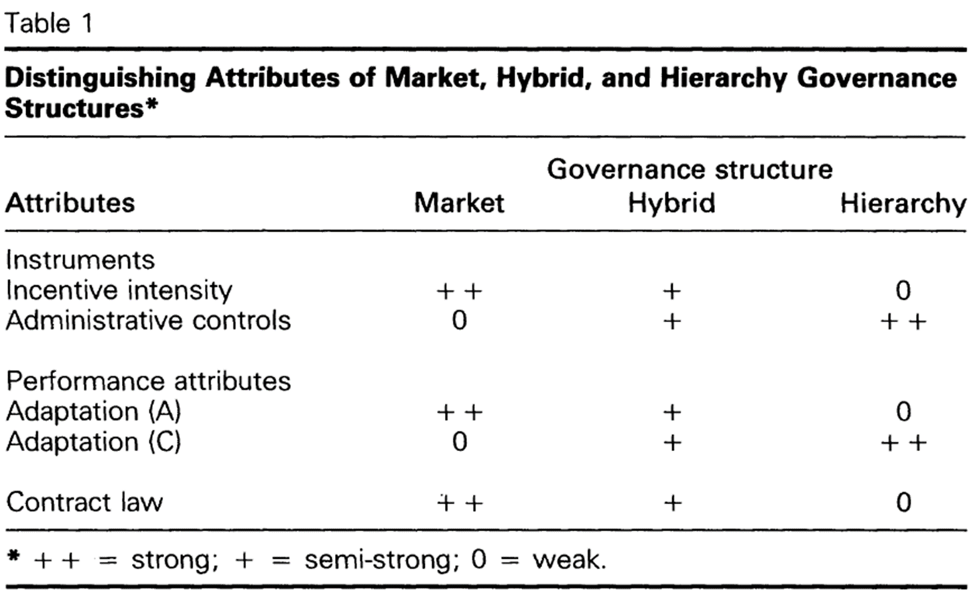
Introduction Discrete Structural Analysis Dimensionalizing Governance Discriminating Alignment Comparative Statics
How do hybrids compare with respect to adaptability (type A and C), incentive intensity, and administrative control?
The hybrid mode displays intermediate values in all four features:
Semi-strong incentives
Intermediate degree of administrative apparatus
Semi-strong adaptations of both kinds
Semi-legalistic contract law regime

Slide 10
Introduction Discrete Structural Analysis Dimensionalizing Governance Discriminating Alignment Comparative Statics
Critical dimensions with respect to which transaction differ:
Frequency
Uncertainty
Asset Specificity
Reduced-form analysis: Governance costs are expressed as a function of asset specificity and a set of exogenous variables.
A condition of bilateral dependency builds up as asset specificity deepens.

Slide 11
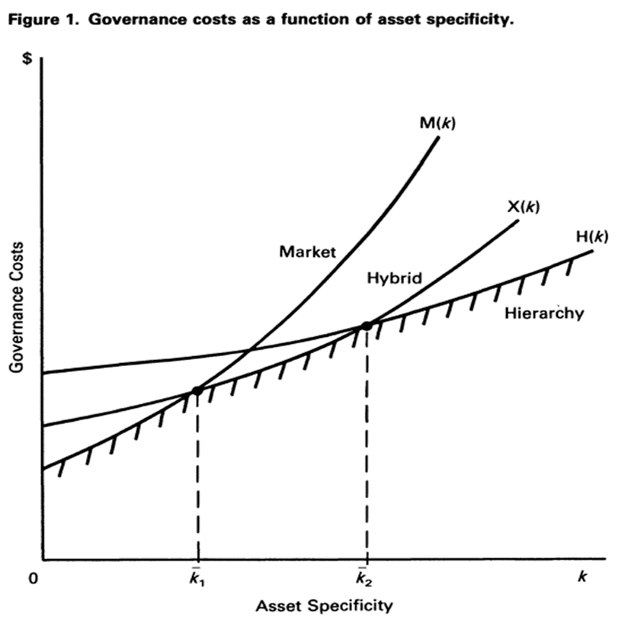
Reduced-Form Analysis
Introduction Discrete Structural Analysis Dimensionalizing Governance Discriminating Alignment Comparative Statics
M(0)<X(0)<H(0)
M’>X’>H’>0
Adaptation (A) → Bureaucratic costs
Adaptation (C) → Bilateral dependency
The hybrid mode is located between market and hierarchy with respect to incentives, adaptability, and bureaucratic costs.
Market
Hybrid
Hierarchy

Slide 12
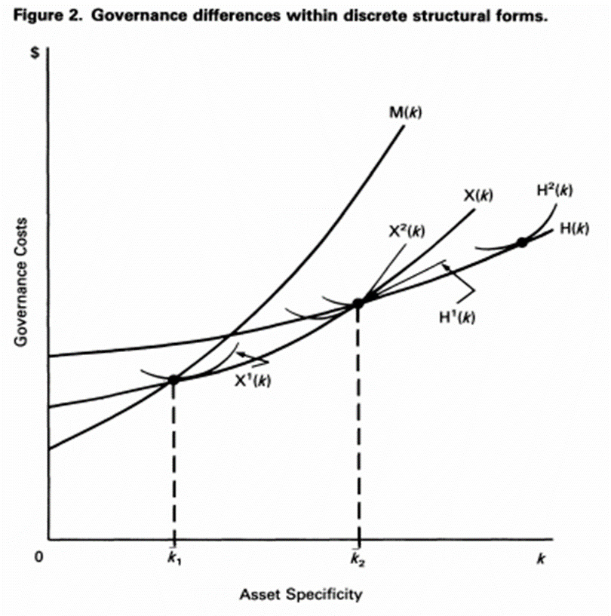
Reduced-Form Analysis
Introduction Discrete Structural Analysis Dimensionalizing Governance Discriminating Alignment Comparative Statics
Two forms of franchising:
X1(k): little control
X2(k): much control
M-form and U-form corporation:
H1(k): M-form
H2(k): U-form
U-form
Much control
M-form
Little control

Slide 13
Introduction Discrete Structural Analysis Dimensionalizing Governance Discriminating Alignment Comparative Statics
How equilibrium distributions of transactions will change in response to disturbances in the institutional environment
Four types of parameter changes can induce a shift from market, to hybrid, to hierarchy (or the reverse)
Property rights
Contract law
Reputation effects
Uncertainty

Slide 14
Introduction Discrete Structural Analysis Dimensionalizing Governance Discriminating Alignment Comparative Statics
1. Property rights
The degree to which property rights, once assigned, have good security features.
Expropriation by the government: $\overline{k_{1}},$and $\overline{k_{2}}$ change little or not at all
Expropriation by commerce (rivals, suppliers, customers): $\overline{k_{2}}$ shifts to the left
2. Contract law
Franchise law: Courts fill in the gaps of an incomplete contract → Increase the cost of franchising in relation to forward integration into distribution → $\overline{k_{2}}$ shifts to the left
Forbearance doctrine: Shift the costs of hierarchical governance up → Disadvantage hierarchy in relation to hybrid modes of contracting → $\overline{k_{2}}$ shifts to the right

Slide 15
Introduction Discrete Structural Analysis Dimensionalizing Governance Discriminating Alignment Comparative Statics
3.Reputation Effects
Improved reputation effects attenuate incentives to behave opportunistically in interfirm trade → Reduce the cost of hybrid contracting → $\overline{k_{2}}$ shifts to the right
4.Uncertainty
Probability distribution of disturbances remains unchanged but that more numerous disturbances occur.
Disturbances become more consequential
Hybrid mode is arguably the most susceptible

Slide 16
Conclusion
The economic problem of society is adaptation (autonomous and coordinated).
Each generic form of governance is shown to rest on a distinctive form of contract law (classical, neoclassical, forbearance).
The hybrid form of organization possesses its own disciplined rationale.
The logic of each generic form of governance - market, hybrid, and hierarchy – is revealed by the dimensionalization and explication of governance.
The institutional environment and the institutions of governance are joined by interpreting the institutional environment as a locus of shift parameters, changes in which parameters induce shifts in the comparative costs of governance.

